Slide 1

Patterns Overview & Map Pattern
Parallel Computing
CIS 410/510
Department of Computer and Information Science

Slide 2
Overview
Dependencies
Patterns
Serial/Parallel Control Patterns
Serial/Parallel Data Management Patterns
Map Pattern
Map
Optimizations
Related Patterns
Example

Slide 3
Parallel Models 101
Sequential models
von Neumann (RAM) model
Parallel model
A parallel computer is simple a collection of processors interconnected in some manner to coordinate activities and exchange data
Models that can be used as general frameworks for describing and analyzing parallel algorithms
Simplicity: description, analysis, architecture independence
Implementability: able to be realized, reflect performance
Three common parallel models
Directed acyclic graphs, shared-memory, network
Memory
(RAM)
processor

Slide 4
Directed Acyclic Graphs (DAG)
Captures data flow parallelism
Nodes represent operations to be performed
Inputs are nodes with no incoming arcs
Output are nodes with no outgoing arcs
Think of nodes as tasks
Arcs are paths for flow of data results
DAG represents the operations of the algorithm and implies precedent constraints on their order
for (i=1; i<100; i++)
a[i] = a[i-1] + 100;
a[0]
a[1]
…
a[99]

Slide 5
Shared Memory Model
Parallel extension of RAM model (PRAM)
Memory size is infinite
Number of processors in unbounded
Processors communicate via the memory
Every processor accesses any memory location in 1 cycle
Synchronous
All processors execute same algorithm synchronously
READ phase
COMPUTE phase
WRITE phase
Some subset of the processors can stay idle
Asynchronous
P₁
Shared
Memory
P₂
P₃
.
.
.
P_{N}

Slide 6
Network Model
G = (N,E)
N are processing nodes
E are bidirectional communication links
Each processor has its own memory
No shared memory is available
Network operation may be synchronous or asynchronous
Requires communication primitives
Send (X, i)
Receive (Y, j)
Captures message passing model for algorithm design
P₁₁
P₁₂
P_{1N}
P₂₁
P₂₂
P_{2N}
P₃₁
P₃₂
P_{3N}
.
.
.
.
.
.
.
.
.
P_{N1}
P_{N2}
P_{NN}

Slide 7
Parallelism
Ability to execute different parts of a computation concurrently on different machines
Why do you want parallelism?
Shorter running time or handling more work
What is being parallelized?
Task: instruction, statement, procedure, …
Data: data flow, size, replication
Parallelism granularity
Coarse-grain versus fine-grainded
Thinking about parallelism
Evaluation

Slide 8
Why is parallel programming important?
Parallel programming has matured
Standard programming models
Common machine architectures
Programmer can focus on computation and use suitable programming model for implementation
Increasing portability between models and architectures
Reasonable hope of portability across platforms
Problem
Performance optimization is still platform-dependent
Performance portability is a problem
Parallel programming methods are still evolving

Slide 9
Parallel Algorithm
Recipe to solve a problem “in parallel” on multiple processing elements
Standard steps for constructing a parallel algorithm
Identify work that can be performed concurrently
Partition the concurrent work on separate processors
Properly manage input, output, and intermediate data
Coordinate data accesses and work to satisfy dependencies
Which are hard to do?

Slide 10
Parallelism Views
Where can we find parallelism?
Program (task) view
Statement level
Between program statements
Which statements can be executed at the same time?
Block level / Loop level / Routine level / Process level
Larger-grained program statements
Data view
How is data operated on?
Where does data reside?
Resource view

Slide 11
Parallelism, Correctness, and Dependence
Parallel execution, from any point of view, will be constrained by the sequence of operations needed to be performed for a correct result
Parallel execution must address control, data, and system dependences
A dependency arises when one operation depends on an earlier operation to complete and produce a result before this later operation can be performed
We extend this notion of dependency to resources since some operations may depend on certain resources
For example, due to where data is located

Slide 12
Executing Two Statements in Parallel
Want to execute two statements in parallel
On one processor:
Statement 1;
Statement 2;
On two processors:
Processor 1: Processor 2:
Statement 1; Statement 2;
Fundamental (concurrent) execution assumption
Processors execute independent of each other
No assumptions made about speed of processor execution

Slide 13
Sequential Consistency in Parallel Execution
Case 1:
Processor 1: Processor 2:
statement 1;
statement 2;
Case 2:
Processor 1: Processor 2:
statement 2;
statement 1;
Sequential consistency
Statements execution does not interfere with each other
Computation results are the same (independent of order)
time
time

Slide 14
Independent versus Dependent
In other words the execution of
statement1;
statement2;
must be equivalent to
statement2;
statement1;
Their order of execution must not matter!
If true, the statements are independent of each other
Two statements are dependent when the order of their execution affects the computation outcome

Slide 15
Examples
Example 1
S1: a=1;
S2: b=1;
Example 2
S1: a=1;
S2: b=a;
Example 3
S1: a=f(x);
S2: a=b;
Example 4
S1: a=b;
S2: b=1;
Statements are independent
Dependent (true (flow) dependence)
Second is dependent on first
Can you remove dependency?
Dependent (output dependence)
Second is dependent on first
Can you remove dependency? How?
Dependent (anti-dependence)
First is dependent on second
Can you remove dependency? How?

Slide 16
True Dependence and Anti-Dependence
Given statements S1 and S2,
S1;
S2;
S2 has a true (flow) dependence on S1
if and only if
S2 reads a value written by S1
S2 has a anti-dependence on S1
if and only if
S2 writes a value read by S1
X =
= X
...
δ
= X
X =
...
δ⁻¹

Slide 17
Output Dependence
Given statements S1 and S2,
S1;
S2;
S2 has an output dependence on S1
if and only if
S2 writes a variable written by S1
Anti- and output dependences are “name” dependencies
Are they “true” dependences?
How can you get rid of output dependences?
Are there cases where you can not?
X =
X =
...
δ⁰

Slide 18
Statement Dependency Graphs
Can use graphs to show dependence relationships
Example
S1: a=1;
S2: b=a;
S3: a=b+1;
S4: c=a;
S₂ δ S₃ : S₃ is flow-dependent on S₂
S₁ δ⁰ S₃ : S₃ is output-dependent on S₁
S₂ δ⁻¹ S₃ : S₃ is anti-dependent on S₂
S1
flow
output
S2
anti
S3
S4

Slide 19
When can two statements execute in parallel?
Statements S1 and S2 can execute in parallel if and only if there are no dependences between S1 and S2
True dependences
Anti-dependences
Output dependences
Some dependences can be remove by modifying the program
Rearranging statements
Eliminating statements

Slide 20
How do you compute dependence?
Data dependence relations can be found by comparing the IN and OUT sets of each node
The IN and OUT sets of a statement S are defined as:
IN(S) : set of memory locations (variables) that may be used in S
OUT(S) : set of memory locations (variables) that may be modified by S
Note that these sets include all memory locations that may be fetched or modified
As such, the sets can be conservatively large

Slide 21
IN / OUT Sets and Computing Dependence
Assuming that there is a path from S1 to S2 , the following shows how to intersect the IN and OUT sets to test for data dependence

Slide 22
Loop-Level Parallelism
Significant parallelism can be identified within loops
for (i=0; i<100; i++) S1: a[i] = i;
Dependencies? What about i, the loop index?
DOALL loop (a.k.a. foreach loop)
All iterations are independent of each other
All statements be executed in parallel at the same time
Is this really true?
for (i=0; i<100; i++) { S1: a[i] = i; S2: b[i] = 2*i; }

Slide 23
Iteration Space
Unroll loop into separate statements / iterations
Show dependences between iterations
for (i=0; i<100; i++)
S1: a[i] = i;
for (i=0; i<100; i++) {
S1: a[i] = i;
S2: b[i] = 2*i;
}
S1⁰
S1¹
…
S1⁹⁹
S1⁰
S1¹
…
S1⁹⁹
S2⁰
S2¹
S2⁹⁹

Slide 24
Multi-Loop Parallelism
Significant parallelism can be identified between loops
for (i=0; i<100; i++) a[i] = i;
for (i=0; i<100; i++) b[i] = i;
Dependencies?
How much parallelism is available?
Given 4 processors, how much parallelism is possible?
What parallelism is achievable with 50 processors?
a[0]
a[1]
…
a[99]
b[0]
b[1]
…
b[99]

Slide 25
Loops with Dependencies
Case 1:
for (i=1; i<100; i++)
a[i] = a[i-1] + 100;
Dependencies?
What type?
Is the Case 1 loop parallelizable?
Is the Case 2 loop parallelizable?
Case 2:
for (i=5; i<100; i++)
a[i-5] = a[i] + 100;
a[0]
a[1]
…
a[99]
a[0]
a[5]
a[10]
…
a[1]
a[6]
a[11]
…
a[2]
a[7]
a[12]
…
a[3]
a[8]
a[13]
…
a[4]
a[9]
a[14]
…

Slide 26
Another Loop Example
for (i=1; i<100; i++)
a[i] = f(a[i-1]);
Dependencies?
What type?
Loop iterations are not parallelizable
Why not?

Slide 27
Loop Dependencies
A loop-carried dependence is a dependence that is present only if the statements are part of the execution of a loop (i.e., between two statements instances in two different iterations of a loop)
Otherwise, it is loop-independent, including between two statements instances in the same loop iteration
Loop-carried dependences can prevent loop iteration parallelization
The dependence is lexically forward if the source comes before the target or lexically backward otherwise
Unroll the loop to see

Slide 28
Loop Dependence Example
for (i=0; i<100; i++)
a[i+10] = f(a[i]);
Dependencies?
Between a[10], a[20], …
Between a[11], a[21], …
Some parallel execution is possible
How much?

Slide 29
Dependences Between Iterations
for (i=1; i<100; i++) {
S1: a[i] = …;
S2: … = a[i-1];
}
Dependencies?
Between a[i] and a[i-1]
Is parallelism possible?
Statements can be executed in “pipeline” manner
S1
…
S2
1
2
3
4
5
6
i

Slide 30
Another Loop Dependence Example
for (i=0; i<100; i++)
for (j=1; j<100; j++)
a[i][j] = f(a[i][j-1]);
Dependencies?
Loop-independent dependence on i
Loop-carried dependence on j
Which loop can be parallelized?
Outer loop parallelizable
Inner loop cannot be parallelized

Slide 31
Still Another Loop Dependence Example
for (j=1; j<100; j++)
for (i=0; i<100; i++)
a[i][j] = f(a[i][j-1]);
Dependencies?
Loop-independent dependence on i
Loop-carried dependence on j
Which loop can be parallelized?
Inner loop parallelizable
Outer loop cannot be parallelized
Less desirable (why?)

Slide 32
Key Ideas for Dependency Analysis
To execute in parallel:
Statement order must not matter
Statements must not have dependences
Some dependences can be removed
Some dependences may not be obvious

Slide 33
Dependencies and Synchronization
How is parallelism achieved when have dependencies?
Think about concurrency
Some parts of the execution are independent
Some parts of the execution are dependent
Must control ordering of events on different processors (cores)
Dependencies pose constraints on parallel event ordering
Partial ordering of execution action
Use synchronization mechanisms
Need for concurrent execution too
Maintains partial order

Slide 34
Parallel Patterns
Parallel Patterns: A recurring combination of task distribution and data access that solves a specific problem in parallel algorithm design.
Patterns provide us with a “vocabulary” for algorithm design
It can be useful to compare parallel patterns with serial patterns
Patterns are universal – they can be used in any parallel programming system

Slide 35
Parallel Patterns
Nesting Pattern
Serial / Parallel Control Patterns
Serial / Parallel Data Management Patterns
Other Patterns
Programming Model Support for Patterns

Slide 36
Nesting Pattern
Nesting is the ability to hierarchically compose patterns
This pattern appears in both serial and parallel algorithms
In our “pattern diagrams” (see next slide), each “task block” is a location of general code in an algorithm
Each “task block” can in turn be another pattern – this is the nesting pattern

Slide 37
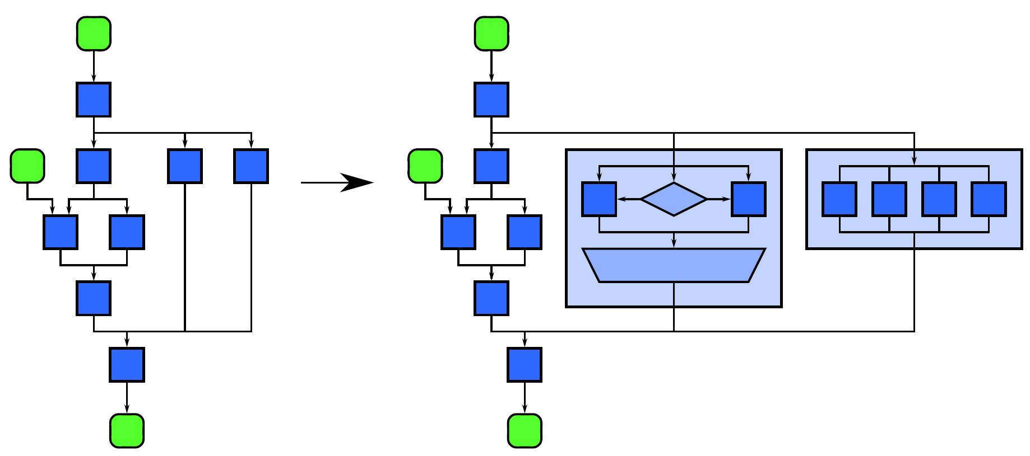
Nesting Pattern
Nesting Pattern: A compositional pattern. Nesting allows other patterns to be composed in a hierarchy so that any task block in the above diagram can be replaced with a pattern with the same input/output and dependencies.

Slide 38
Serial Control Patterns
Structured serial programming is based on these patterns: sequence, selection, iteration, and recursion
The nesting pattern can also be used to hierarchically compose these four patterns
Though you should be familiar with these, it’s extra important to understand these patterns when parallelizing serial algorithms based on these patterns

Slide 39

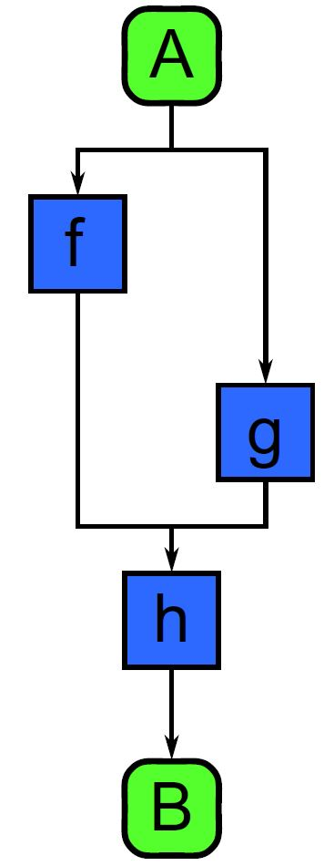
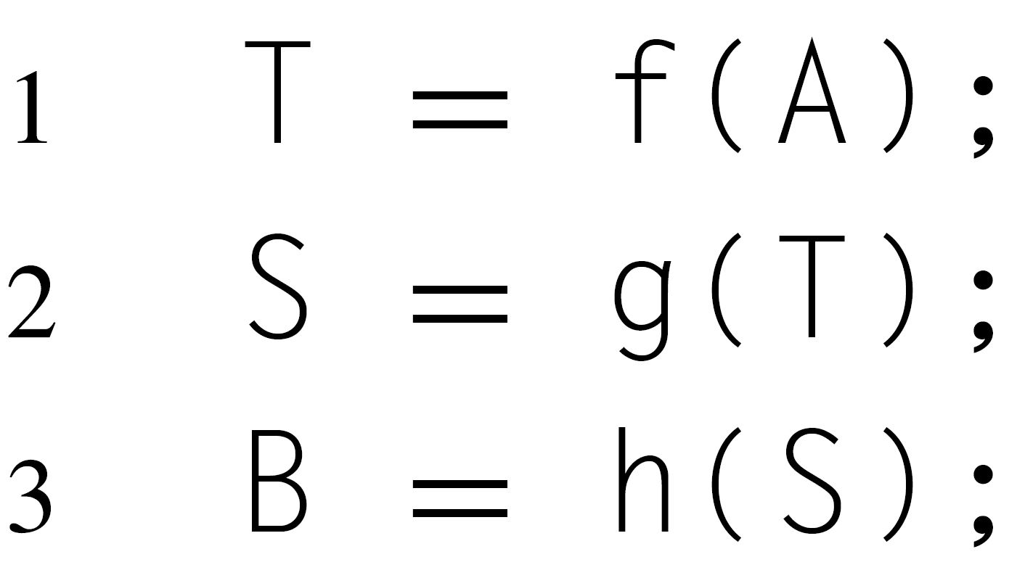
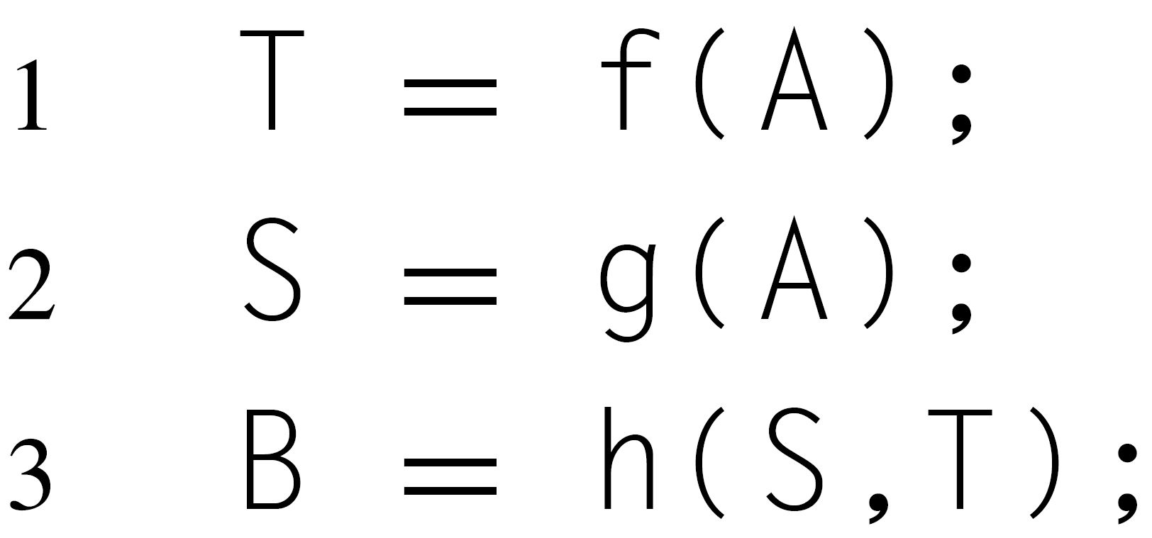
Serial Control Patterns: Sequence
Sequence: Ordered list of tasks that are executed in a specific order
Assumption – program text ordering will be followed (obvious, but this will be important when parallelized)

Slide 40
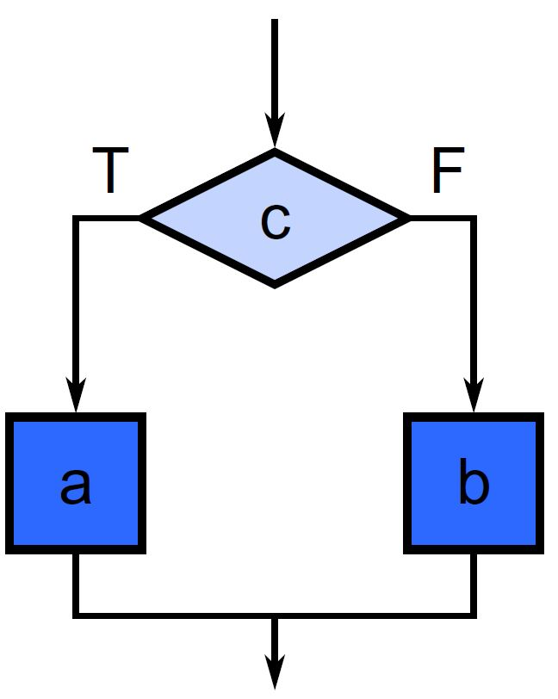
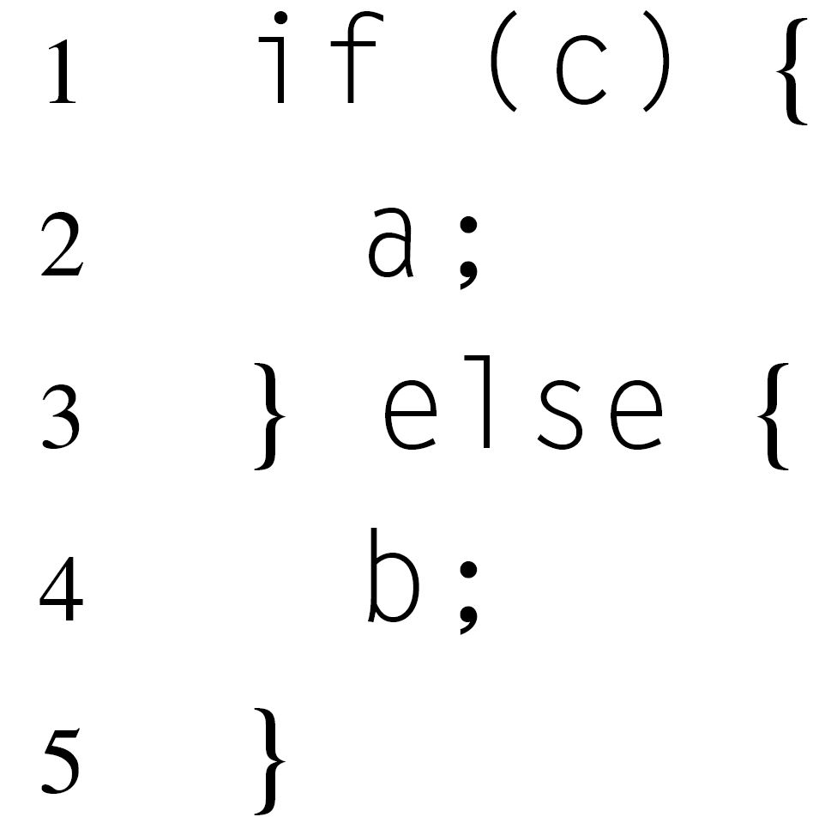
Serial Control Patterns: Selection
Selection: condition c is first evaluated. Either task a or b is executed depending on the true or false result of c.
Assumptions – a and b are never executed before c, and only a or b is executed - never both

Slide 41
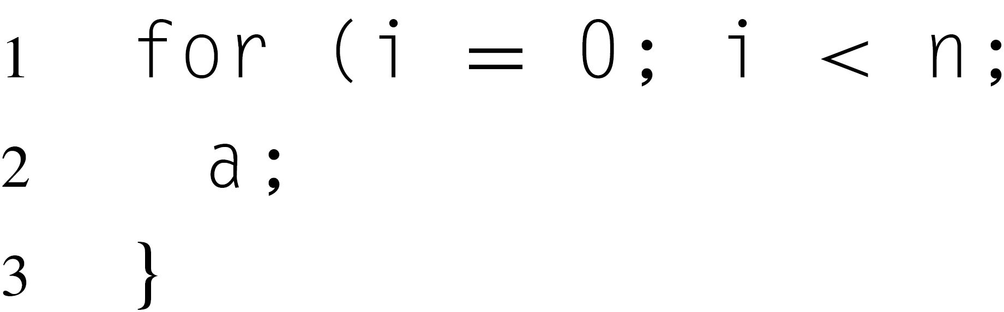
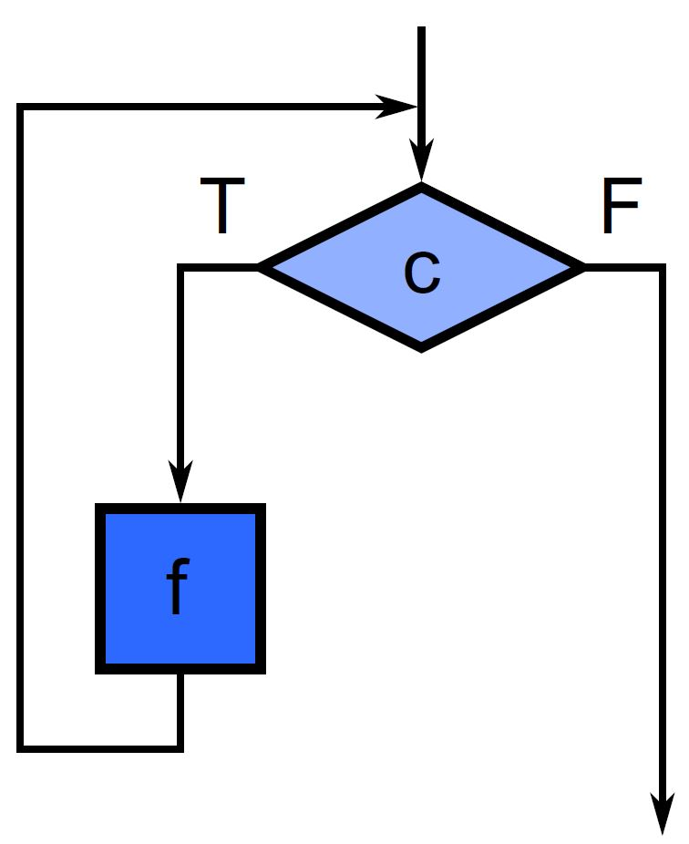
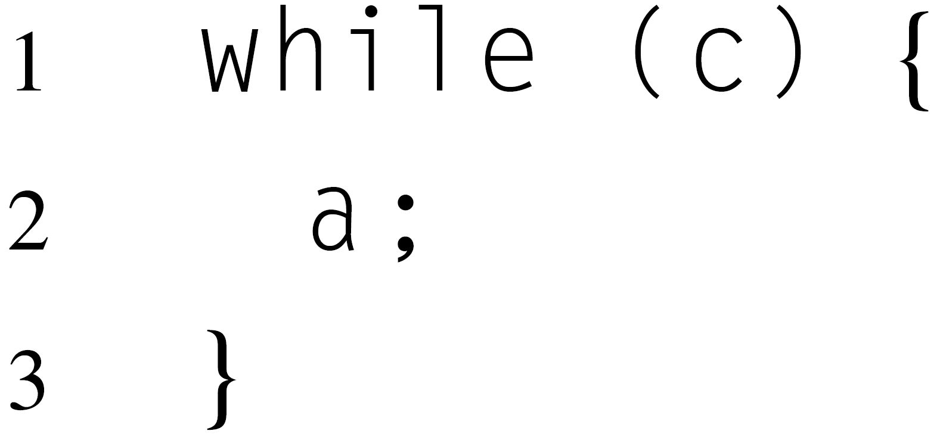
Serial Control Patterns: Iteration
Iteration: a condition c is evaluated. If true, a is evaluated, and then c is evaluated again. This repeats until c is false.
Complication when parallelizing: potential for dependencies to exist between previous iterations

Slide 42
Serial Control Patterns: Recursion
Recursion: dynamic form of nesting allowing functions to call themselves
Tail recursion is a special recursion that can be converted into iteration – important for functional languages

Slide 43
Parallel Control Patterns
Parallel control patterns extend serial control patterns
Each parallel control pattern is related to at least one serial control pattern, but relaxes assumptions of serial control patterns
Parallel control patterns: fork-join, map, stencil, reduction, scan, recurrence

Slide 44
Parallel Control Patterns: Fork-Join
Fork-join: allows control flow to fork into multiple parallel flows, then rejoin later
Cilk Plus implements this with spawn and sync
The call tree is a parallel call tree and functions are spawned instead of called
Functions that spawn another function call will continue to execute
Caller syncs with the spawned function to join the two
A “join” is different than a “barrier
Sync – only one thread continues
Barrier – all threads continue

Slide 45
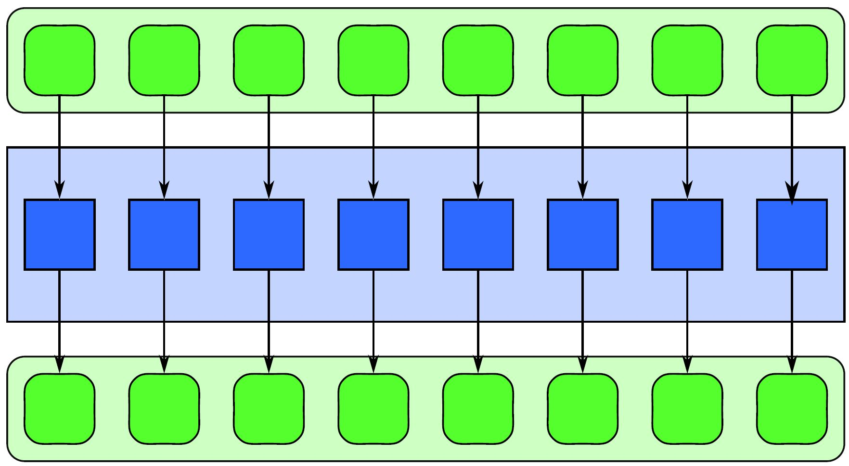
Parallel Control Patterns: Map
Map: performs a function over every element of a collection
Map replicates a serial iteration pattern where each iteration is independent of the others, the number of iterations is known in advance, and computation only depends on the iteration count and data from the input collection
The replicated function is referred to as an “elemental function”
Input
Elemental Function
Output

Slide 46
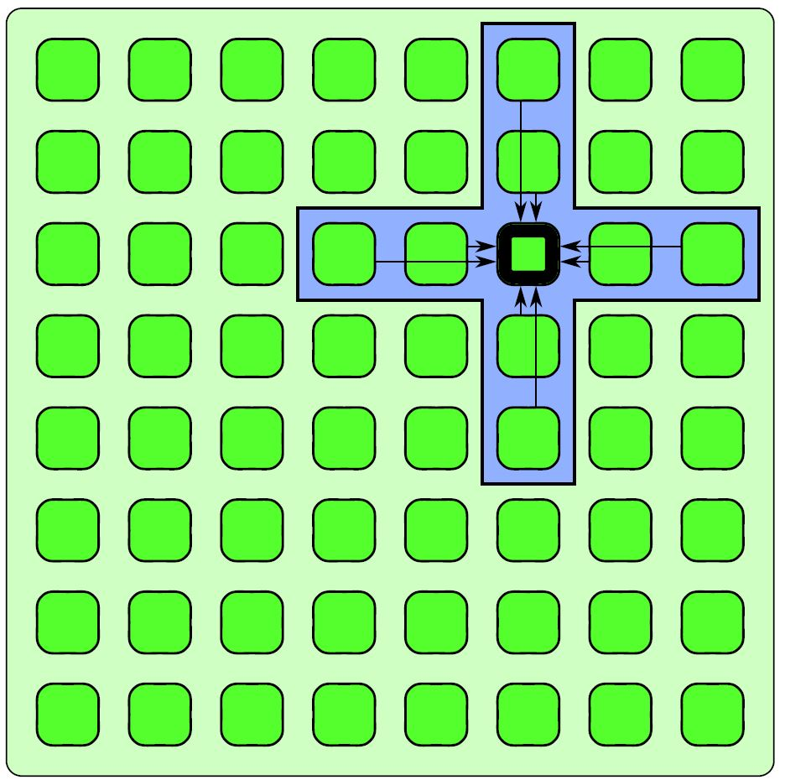
Parallel Control Patterns: Stencil
Stencil: Elemental function accesses a set of “neighbors”, stencil is a generalization of map
Often combined with iteration – used with iterative solvers or to evolve a system through time
Boundary conditions must be handled carefully in the stencil pattern. More on this in the stencil lecture…

Slide 47
Parallel Control Patterns: Reduction
Reduction: Combines every element in a collection using an associative “combiner function”
Because of the associativity of the combiner function, different orderings of the reduction are possible
Examples of combiner functions: addition, multiplication, maximum, minimum, and Boolean AND, OR, and XOR

Slide 48
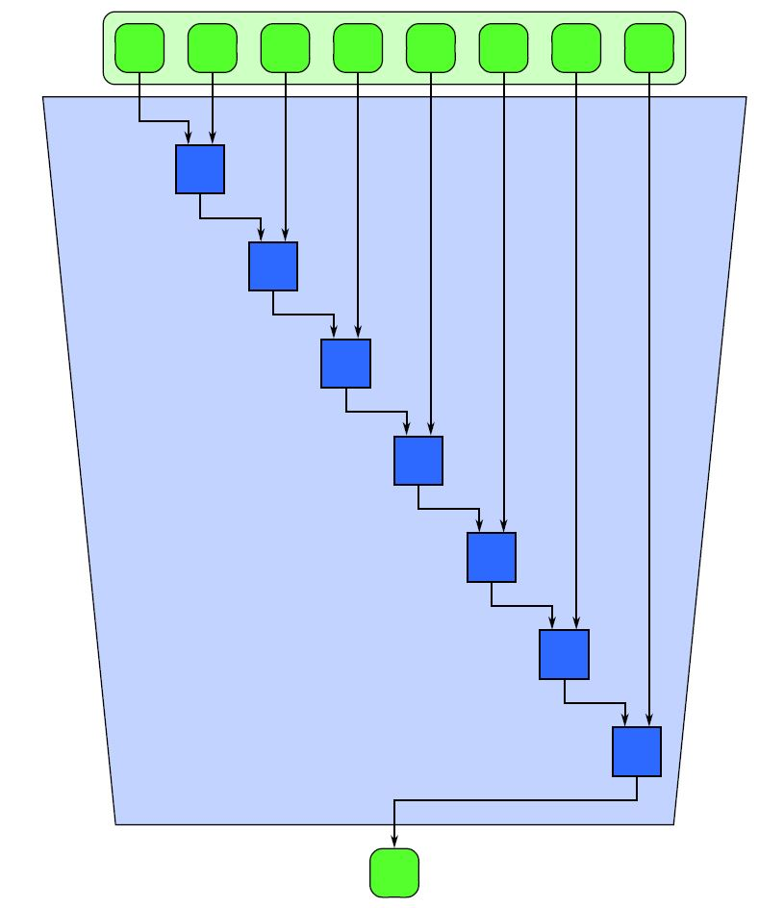
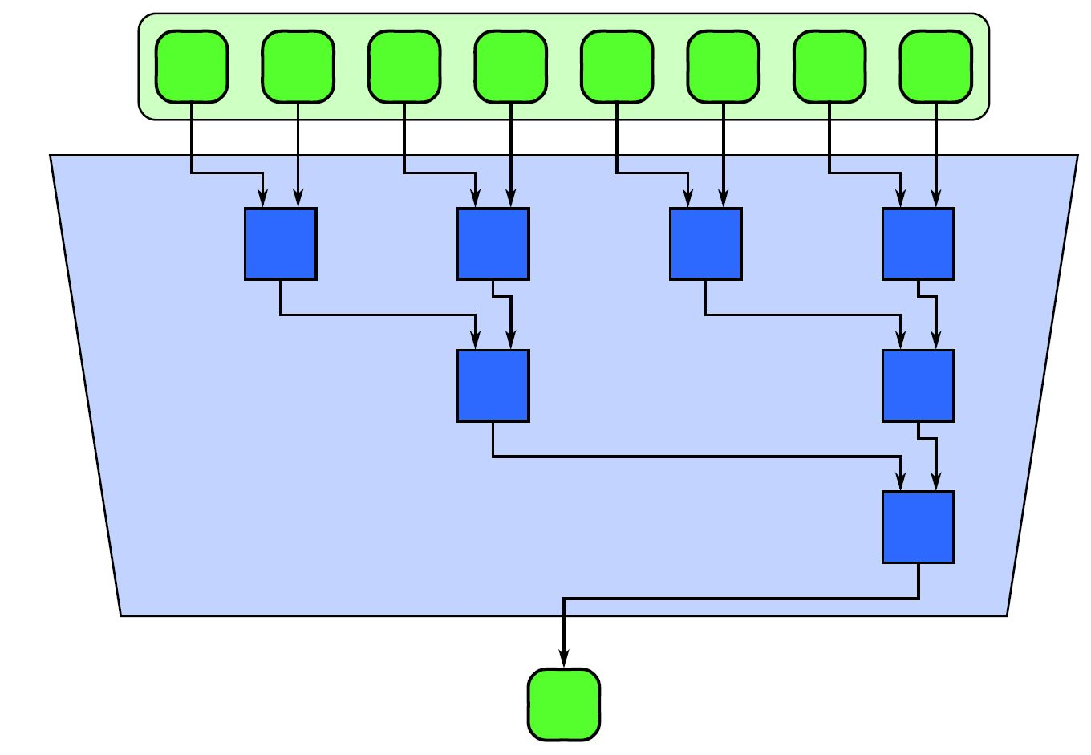
Parallel Control Patterns: Reduction
Serial Reduction
Parallel Reduction

Slide 49
Parallel Control Patterns: Scan
Scan: computes all partial reduction of a collection
For every output in a collection, a reduction of the input up to that point is computed
If the function being used is associative, the scan can be parallelized
Parallelizing a scan is not obvious at first, because of dependencies to previous iterations in the serial loop
A parallel scan will require more operations than a serial version

Slide 50
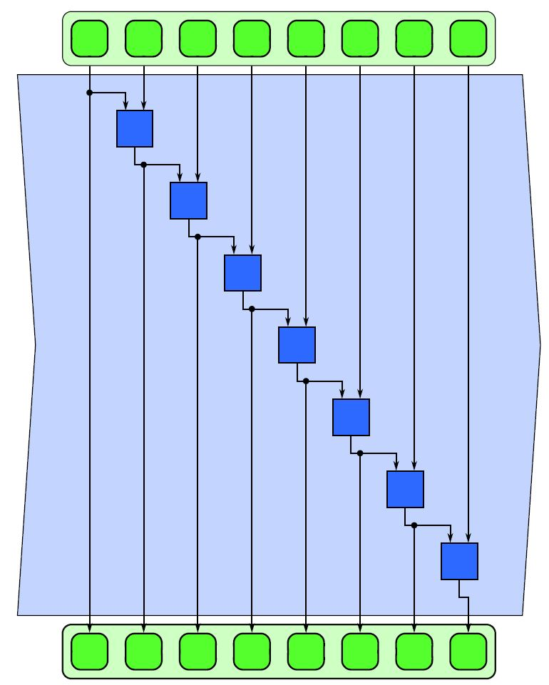
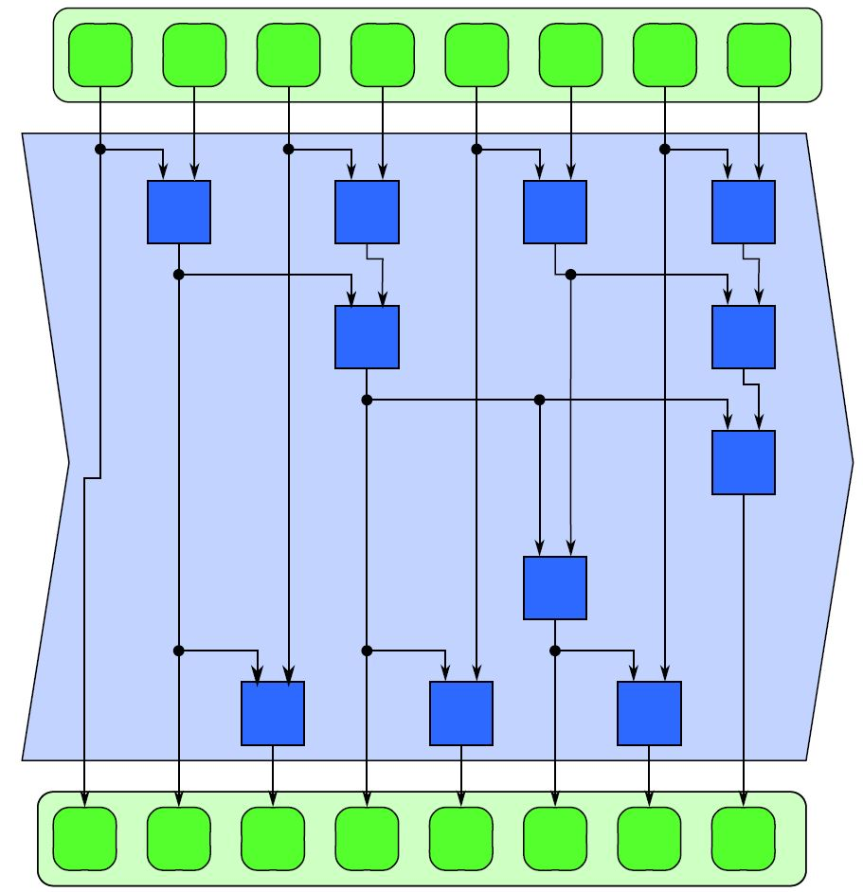
Parallel Control Patterns: Scan
Serial Scan
Parallel Scan

Slide 51
Parallel Control Patterns: Recurrence
Recurrence: More complex version of map, where the loop iterations can depend on one another
Similar to map, but elements can use outputs of adjacent elements as inputs
For a recurrence to be computable, there must be a serial ordering of the recurrence elements so that elements can be computed using previously computed outputs

Slide 52
Serial Data Management Patterns
Serial programs can manage data in many ways
Data management deals with how data is allocated, shared, read, written, and copied
Serial Data Management Patterns: random read and write, stack allocation, heap allocation, objects

Slide 53
Serial Data Management Patterns: random read and write
Memory locations indexed with addresses
Pointers are typically used to refer to memory addresses
Aliasing (uncertainty of two pointers referring to the same object) can cause problems when serial code is parallelized

Slide 54
Serial Data Management Patterns: Stack Allocation
Stack allocation is useful for dynamically allocating data in LIFO manner
Efficient – arbitrary amount of data can be allocated in constant time
Stack allocation also preserves locality
When parallelized, typically each thread will get its own stack so thread locality is preserved

Slide 55
Serial Data Management Patterns: Heap Allocation
Heap allocation is useful when data cannot be allocated in a LIFO fashion
But, heap allocation is slower and more complex than stack allocation
A parallelized heap allocator should be used when dynamically allocating memory in parallel
This type of allocator will keep separate pools for each parallel worker

Slide 56
Serial Data Management Patterns: Objects
Objects are language constructs to associate data with code to manipulate and manage that data
Objects can have member functions, and they also are considered members of a class of objects
Parallel programming models will generalize objects in various ways

Slide 57
Parallel Data Management Patterns
To avoid things like race conditions, it is critically important to know when data is, and isn’t, potentially shared by multiple parallel workers
Some parallel data management patterns help us with data locality
Parallel data management patterns: pack, pipeline, geometric decomposition, gather, and scatter

Slide 58
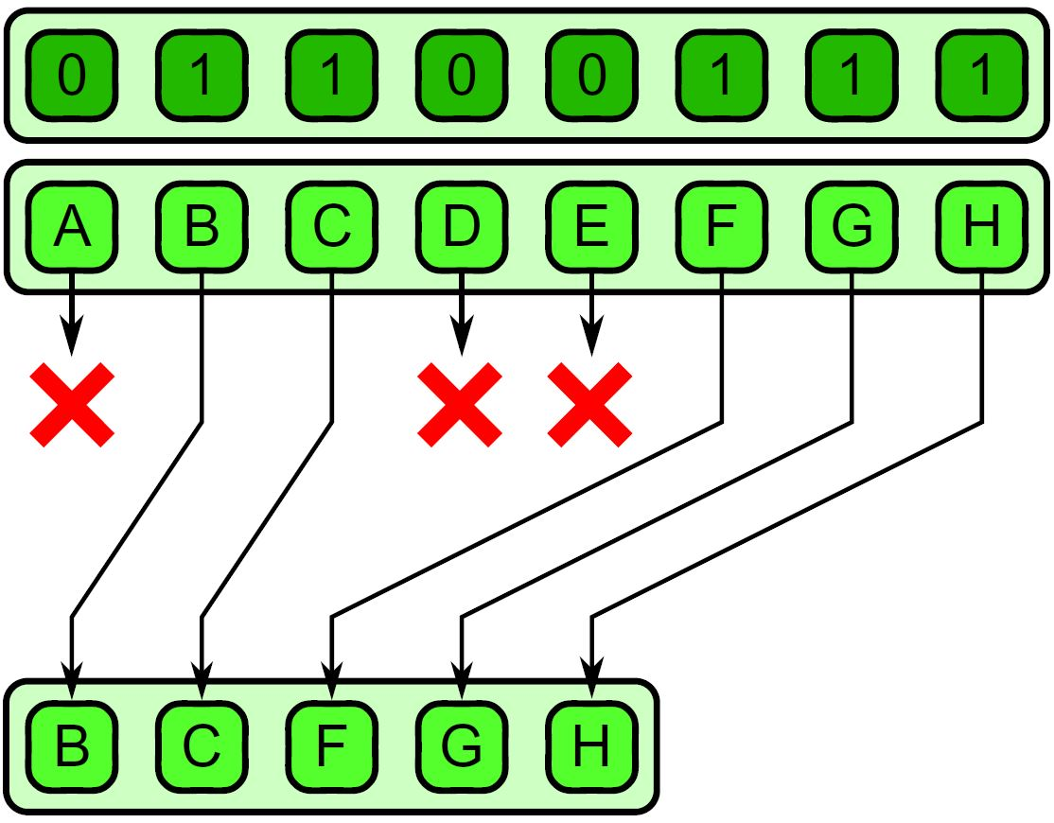
Parallel Data Management Patterns: Pack
Pack is used eliminate unused space in a collection
Elements marked false are discarded, the remaining elements are placed in a contiguous sequence in the same order
Useful when used with
map
Unpack is the inverse
and is used to place
elements back in their
original locations

Slide 59
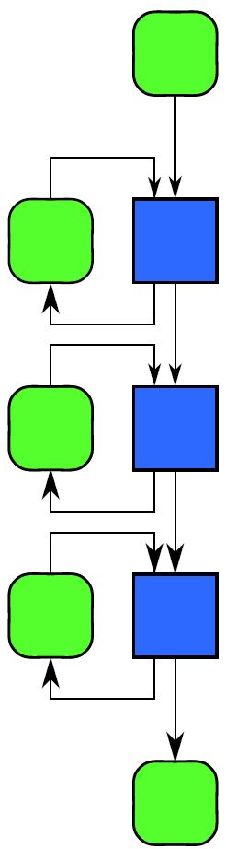
Parallel Data Management Patterns: Pipeline
Pipeline connects tasks in a producer-consumer manner
A linear pipeline is the basic pattern idea, but a pipeline in a DAG is also possible
Pipelines are most useful when used with other patterns as they can multiply available parallelism

Slide 60
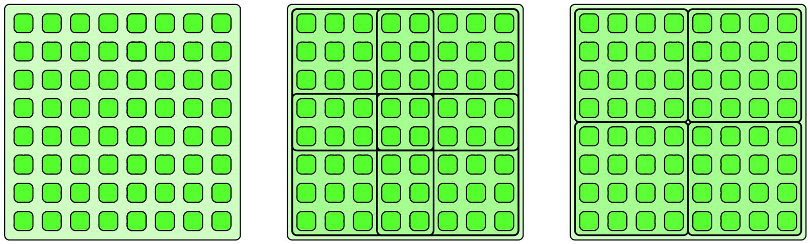
Parallel Data Management Patterns: Geometric Decomposition
Geometric Decomposition – arranges data into subcollections
Overlapping and non-overlapping decompositions are possible
This pattern doesn’t necessarily move data, it just gives us another view of it

Slide 61
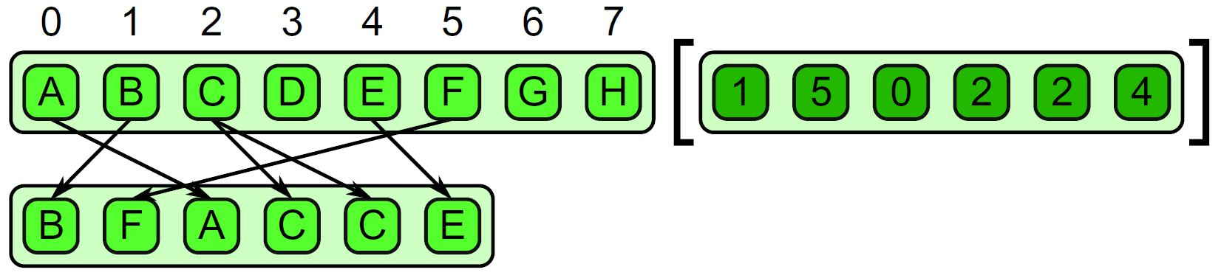
Parallel Data Management Patterns: Gather
Gather reads a collection of data given a collection of indices
Think of a combination of map and random serial reads
The output collection shares the same type as the input collection, but it share the same shape as the indices collection

Slide 62
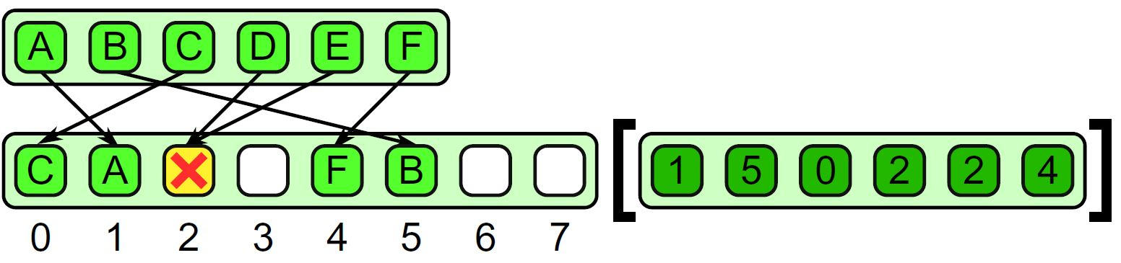
Parallel Data Management Patterns: Scatter
Scatter is the inverse of gather
A set of input and indices is required, but each element of the input is written to the output at the given index instead of read from the input at the given index
Race conditions can occur when we have two writes to the same location!

Slide 63
Other Parallel Patterns
Superscalar Sequences: write a sequence of tasks, ordered only by dependencies
Futures: similar to fork-join, but tasks do not need to be nested hierarchically
Speculative Selection: general version of serial selection where the condition and both outcomes can all run in parallel
Workpile: general map pattern where each instance of elemental function can generate more instances, adding to the “pile” of work

Slide 64
Other Parallel Patterns
Search: finds some data in a collection that meets some criteria
Segmentation: operations on subdivided, non-overlapping, non-uniformly sized partitions of 1D collections
Expand: a combination of pack and map
Category Reduction: Given a collection of elements each with a label, find all elements with same label and reduce them

Slide 65
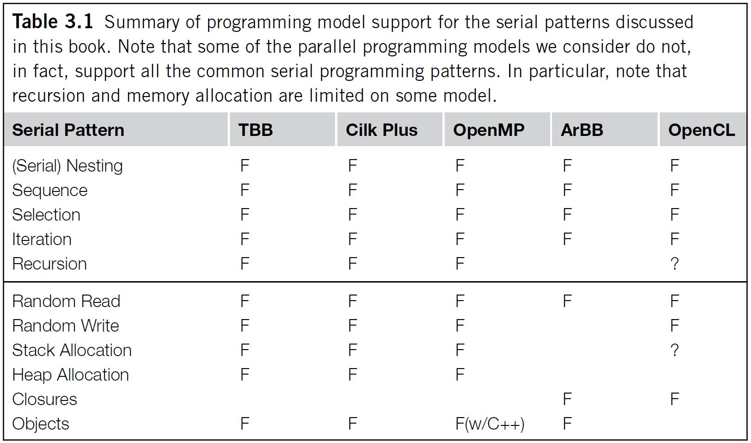
Programming Model Support for Patterns

Slide 66
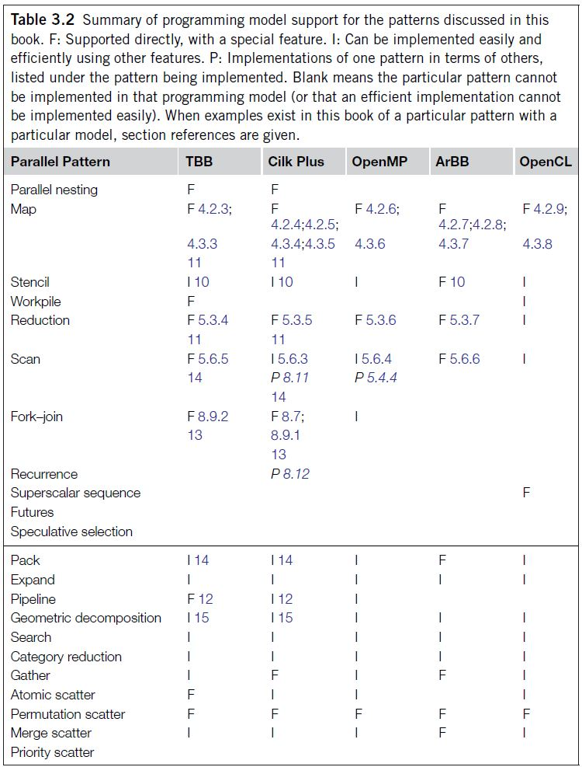
Programming Model Support for Patterns

Slide 67
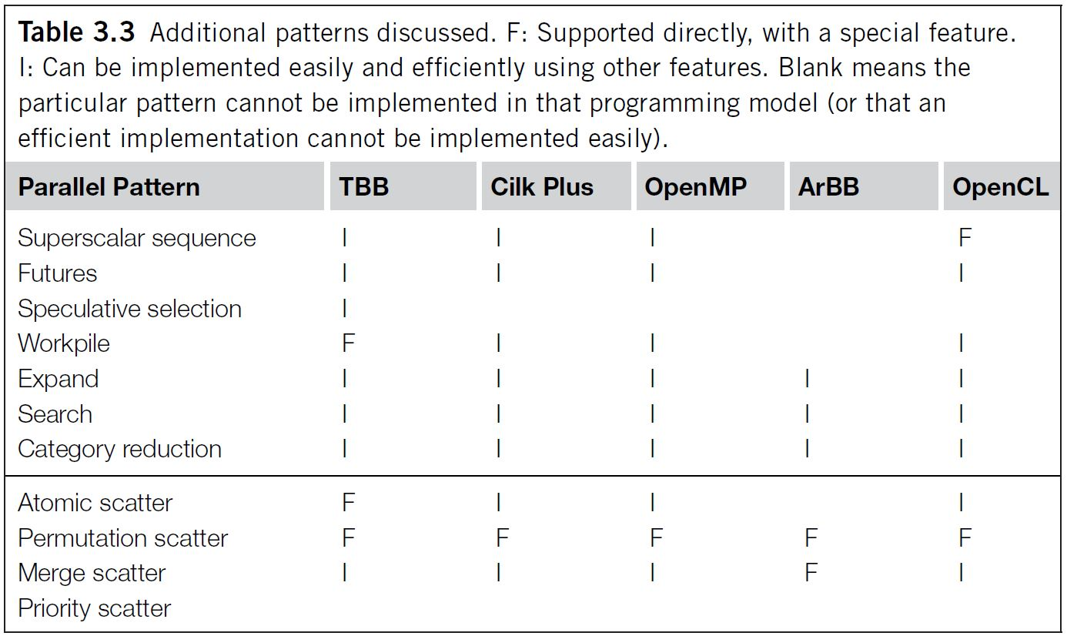
Programming Model Support for Patterns

Slide 68
Map Pattern

Slide 69
Map Pattern - Overview
Map
Optimizations
Sequences of Maps
Code Fusion
Cache Fusion
Related Patterns
Example Implementation: Scaled Vector Addition (SAXPY)
Problem Description
Various Implementations

Slide 70
Map
“Do the same thing many times”
foreach i in foo:
do something
Applies a function to each element in a list and returns a list of results

Slide 71
Example Maps
Add 1 to every item in an array
Double every item in an array
0
1
2
3
4
5
0
1
2
3
4
5
0
4
5
3
1
0
3
7
0
1
4
0
1
5
6
4
2
1
6
14
0
2
8
0
Key Point: An operation is a map if it can be applied to each element without knowledge of neighbors.

Slide 72
Key Idea
Map is a “foreach loop” where each iteration is independent
Embarrassingly Parallel
Independence is key to map. We can run map completely in parallel. Significant speedups! More precisely: is O(1) plus implementation overhead that is O(log n)…so .

Slide 73
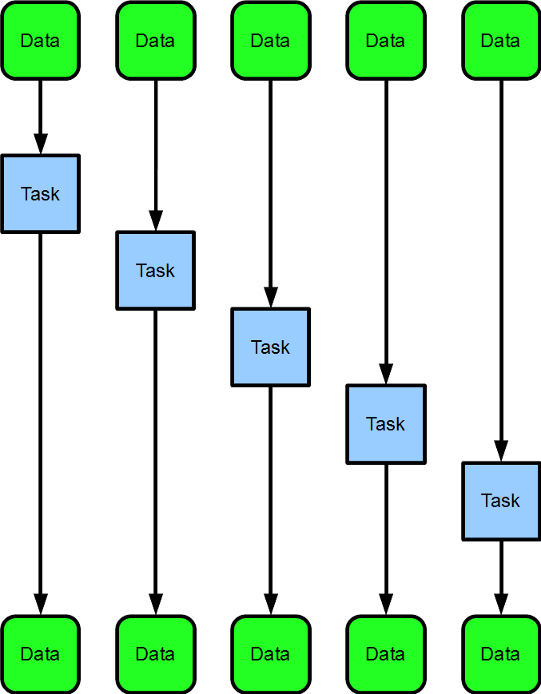
Sequential Map
for(int n=0;
n< array.length;
++n){
process(array[n]);
}
Time

Slide 74
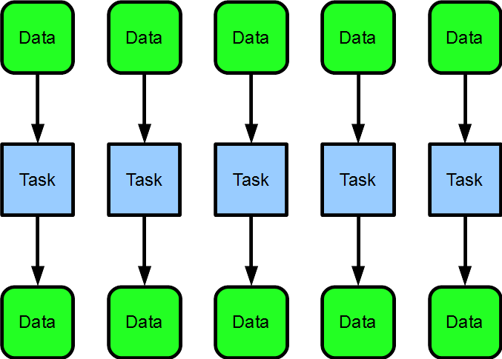
Parallel Map
parallel_for_each(
x in array){
process(x);
}
Time

Slide 75
Comparing Maps
Serial Map
Parallel Map

Slide 76
Comparing Maps
Serial Map
Parallel Map
Speedup
The space is speedup. With the parallel map, our program finished execution early, while the serial map is still running.

Slide 77
Independence
The key to (embarrassing) parallelism is independence
Modifying shared state breaks perfect independence
Results of accidentally violating independence:
non-determinism
data-races
undefined behavior
segfaults
Warning: No shared state!
Map function should be “pure” and should not modify shared states

Slide 78
Implementation and API
OpenMP and CilkPlus contain a parallel for language construct
Map is a mode of use of parallel for
TBB uses higher order functions with lambda expressions/“funtors”
Some languages (CilkPlus, Matlab, Fortran) provide array notation which makes some maps more concise
Array Notation
A[:] = A[:]*5;
is CilkPlus array notation for “multiply every element in A by 5”

Slide 79
Unary Maps
Unary Maps
So far we have only dealt with mapping over a single collection…

Slide 80
Map with 1 Input, 1 Output
0
1
2
3
4
5
6
7
8
9
10
11
x
3
7
0
1
4
0
0
4
5
3
1
0
result
6
14
0
2
8
0
0
8
10
6
2
0
int oneToOne ( int x[11] ) {
return x*2;
}

Slide 81
N-ary Maps
N-ary Maps
But, sometimes it makes sense to map over multiple collections at once…

Slide 82
Map with 2 Inputs, 1 Output
0
1
2
3
4
5
6
7
8
9
10
11
x
3
7
0
1
4
0
0
4
5
3
1
0
y
2
4
2
1
8
3
9
5
5
1
2
1
result
5
11
2
2
12
3
9
9
10
4
3
1
int twoToOne ( int x[11], int y[11] ) {
return x+y;
}

Slide 83
Map Pattern - Overview
Map
Optimizations
Sequences of Maps
Code Fusion
Cache Fusion
Related Patterns
Example Implementation: Scaled Vector Addition (SAXPY)
Problem Description
Various Implementations

Slide 84
Sequences of Maps
Often several map operations occur in sequence
Vector math consists of many small operations such as additions and multiplications applied as maps
A naïve implementation may write each intermediate result to memory, wasting memory BW and likely overwhelming the cache

Slide 85
Code Fusion
Can sometimes “fuse” together the operations to perform them at once
Adds arithmetic intensity, reduces memory/cache usage
Ideally, operations can be performed using registers alone

Slide 86
Cache Fusion
Sometimes impractical to fuse together the map operations
Can instead break the work into blocks, giving each CPU one block at a time
Hopefully, operations use cache alone

Slide 87
Related Patterns to Map
Three patterns related to map are discussed here:
Stencil
Workpile
Divide-and-Conquer
They will be discussed more in detail in a later lecture.

Slide 88
Stencil
Each instance of the map function accesses neighbors of its input, offset from its usual input
Common in imaging and PDE solvers

Slide 89
Workpile
Work items can be added to the map while it is in progress, from inside map function instances
The “pile” of work grows and is consumed by the map
Workpile pattern terminates when no more work is available

Slide 90
Divide-and-Conquer
Applies if a problem can be divided into smaller subproblems recursively until a base case is reached that can be solved serially

Slide 91
Map Pattern - Overview
Map
Optimizations
Sequences of Maps
Code Fusion
Cache Fusion
Related Patterns
Example Implementation: Scaled Vector Addition (SAXPY)
Problem Description
Various Implementations

Slide 92
Problem Description
Scales vector x by a and adds it to vector y
Result is stored in input vector y
Comes from the BLAS (Basic Linear Algebra Subprograms) library
Every element in vector x and vector y are independent

Slide 93
Visual:
0
1
2
3
4
5
6
7
8
9
10
11
a
4
4
4
4
4
4
4
4
4
4
4
4
*
x
2
4
2
1
8
3
9
5
5
1
2
1
+
y
3
7
0
1
4
0
0
4
5
3
1
0
y
11
23
8
5
36
12
36
49
50
7
9
4

Slide 94
Visual:
0
1
2
3
4
5
6
7
8
9
10
11
a
4
4
4
4
4
4
4
4
4
4
4
4
*
x
2
4
2
1
8
3
9
5
5
1
2
1
+
y
3
7
0
1
4
0
0
4
5
3
1
0
y
11
23
8
5
36
12
36
49
50
7
9
4
Twelve processors used → one for each element in the vector

Slide 95
Visual:
0
1
2
3
4
5
6
7
8
9
10
11
a
4
4
4
4
4
4
4
4
4
4
4
4
*
x
2
4
2
1
8
3
9
5
5
1
2
1
+
y
3
7
0
1
4
0
0
4
5
3
1
0
y
11
23
8
5
36
12
36
49
50
7
9
4
Six processors used → one for every two elements in the vector

Slide 96
Visual:
0
1
2
3
4
5
6
7
8
9
10
11
a
4
4
4
4
4
4
4
4
4
4
4
4
*
x
2
4
2
1
8
3
9
5
5
1
2
1
+
y
3
7
0
1
4
0
0
4
5
3
1
0
y
11
23
8
5
36
12
36
49
50
7
9
4
Two processors used → one for every six elements in the vector

Slide 97
Serial SAXPY Implementation

Slide 98
TBB SAXPY Implementation

Slide 99
Cilk Plus SAXPY Implementation

Slide 100
OpenMP SAXPY Implentation

Slide 101
OpenMP SAXPY Performance

